Slide 1
Hairpins Laser Welding
A suitable technology for improved efficiency
Contents at a glance
Our equipment
Stripping and Welding processes

Slide 2
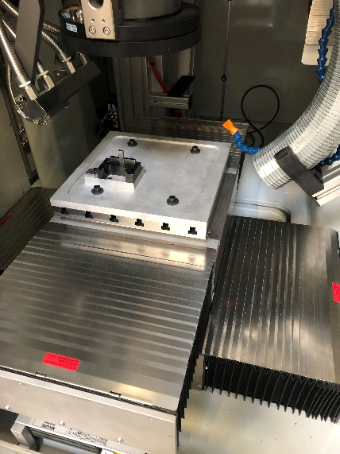
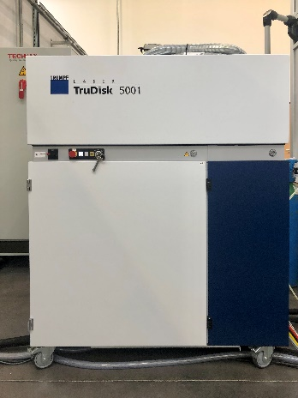
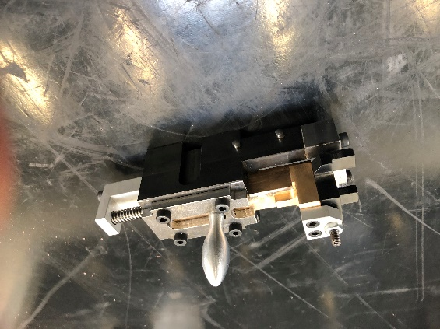
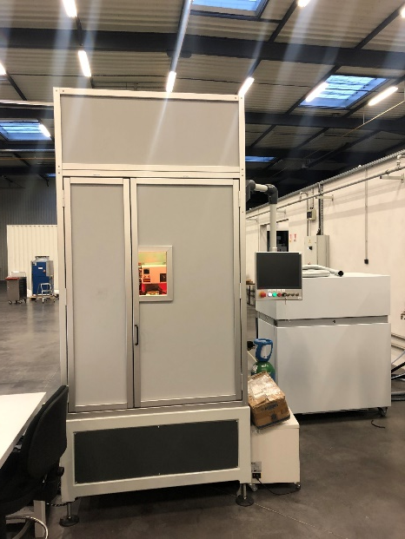
Our Industrial Laser Machine
TruDisk_5001 from Trumpf :
A solid-disc laser machine
BrightLine Weld Technology
VisionLine control system
Programmable PFO Optics : PFO 33
Power : 120 – 5000 W
Wave length : 1030 nm
Beam quality : 4 mm.mrad
Focal distance : 239,5 mm
TECHNAX machine installation :
3 digital axes
Confined and secure enclosure
Pneumatic inert gas circuit
Example of TECHNAX tools (Hairpin):
A Stripping position
A Welding position

Slide 3
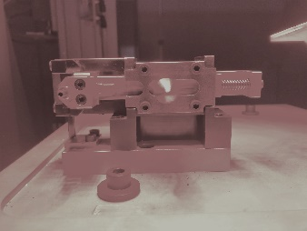
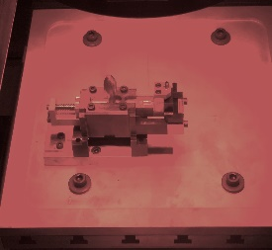
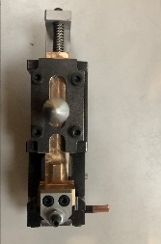
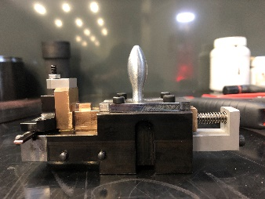
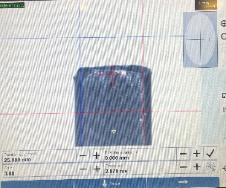
Stripping process
Test parts (enamelled copper terminals) are cut on a template
5. Tool is placed on the holding table
10. When the laser is initialized, the laser stripping program starts
6. Height of the Pin is adjusted by the second stop
11. Same process is repeated for the other side of the part (Step 4)
2. Ends of these parts are flattened
7. Tool is placed in Stripping position
12. Second part is stripped following the same procedure
3. One part is placed in the tool
8. Digital axes are adjusted relative to the position of the Pin
4. First mechanical adjustement stop is calibrated
13. Finally, part stripped sides are cleaned with ethanol
9. Pneumatic circuit and the laser are switched on
25.11.2020
3

Slide 4
Stripping process
Laser stripping Program parameters
Power : 275 W – 100% ring
Duration of the process for one side : 953 ms
Energy consumption : 25,69 J

Slide 5
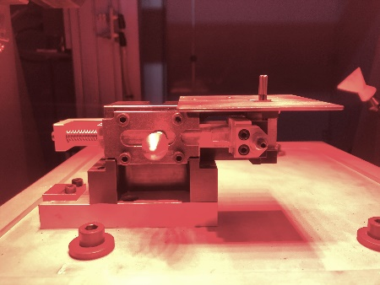
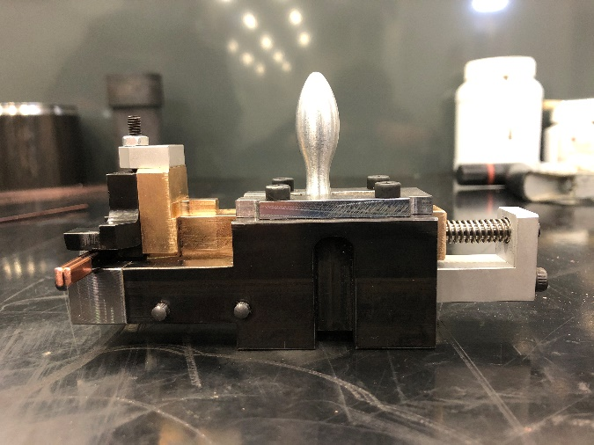
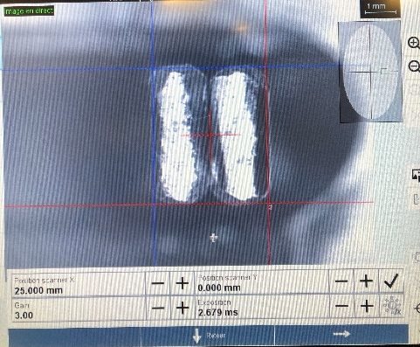
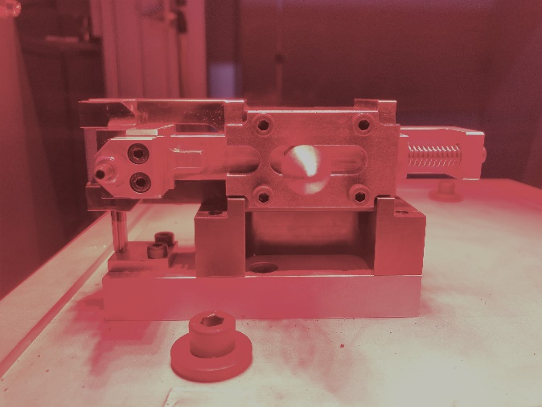
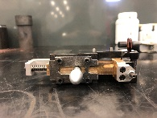
Welding process
5. Tool is loaded in welding position
1. Both stripped parts are placed in the holding tool
2. First mechanical adjustement stop is calibrated
6. The digital axes are adjusted relative to the position of the Pins
3. Tool is put on the holding table
7. The pneumatic circuit and the laser are switched
4. Height of the Pins is adjusted by the second stop
8. After machine initialization, the laser welding program starts

Slide 6
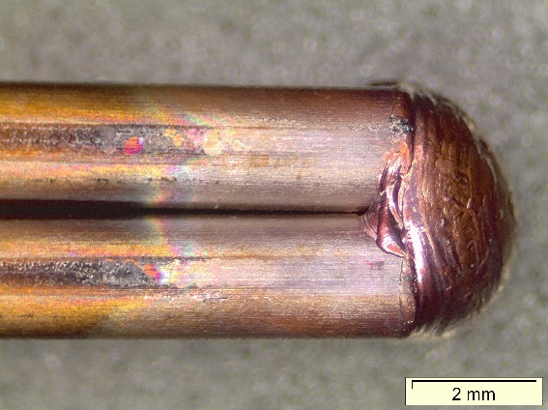
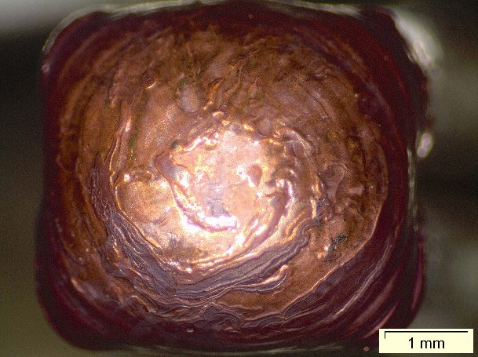
Welding process
Laser welding Program parameters
Power : 3500 W – 100% heart
Duration of the process : 298 ms
Energy consumption : 40,19 J

